Slide 1
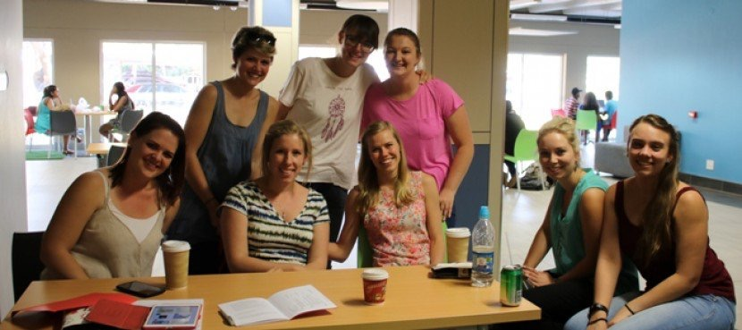
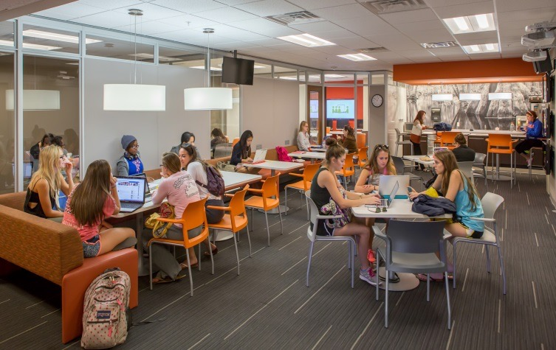
Department of Psychology
Learning communities: An online initiative to improve student performance
Presented by Ms Sonja N Mostert
27 March 2018

Slide 2
OUTLINE
What is a learning community?
Purpose of learning communities
Hybrid learning: The “millennials”
Learning community activities
The value of learning communities
Student feedback:
Advantages, disadvantages and suggestions
The future of learning communities

Slide 3
What is a learning community ?
Experience
Goals
Support
Learning communities:
Small groups of students
sharing a few modules or courses; academic goals, career options and tutorial classes
Collaboration between lecturers and tutors to facilitate learning
Students can learn from each other and support each other beyond a classroom setting
Resource
Participation
Learning
Cohesion
Education

Slide 4
Learning communities: a brief overview
Learning communities attempt to reach ALL students
Making learning accessible to all students
Some are unable to attend tutorials
The online platform allows learners to communicate and engage with the module content
It is a space to provide academic support in the event of unforeseen circumstance
Protests

Slide 5
Purpose of a learning community
Increase engagement with the module content beyond the lecture halls
A platform to communicate academically and socially with tutors and fellow students
Share knowledge and ideas
Make learning easier, convenient and less intimidating

Slide 6
Purpose of a learning community
Identify problem areas
Provides additional preparation for tests and examinations
Improve pass rates
A support system for the students
Encourages interactive learning

Slide 7
Hybrid Learning
The ‘Millennials’
Generation ‘WiFi’
New generation of students - reliant on technology
The teaching methods from the past will no longer be effective
Hybrid learning
Integrating technology with face-to-face teaching
Combining lecture attendance and tutorials with learning that involves online components
de Prez, 2016; Dias & Diniz, 2014; Monaco & Martin, 2007; Reyneke & Fletcher, 2014

Slide 8
Learning communities: a form of Hybrid Learning
Opportunity to apply knowledge, and to test their understanding of the content
It offers convenience and flexibility to the students
complete activities in their own time
students can raise questions in a space they feel comfortable
Learning communities are a means to foster hybrid learning

Slide 9
ClickUp and Learning communities
3 Campuses
6 learning communities
Each group was managed and facilitated by two first year tutors

Slide 10
Learning community activities
Weekly assignments were created based on lecture content
Assignments: multiple choice questions, integrative questions and short paragraph questions
Each assignment was posted at the beginning of the week followed by the memorandum at the end of the week
Students were able to discuss assignments during tutorials or use the online discussion board to ask fellow students
Practice tests were made available
Information sheets and brain maps were created to help with exam/test preparation

Slide 11
The value of Learning communities
Limited assessment opportunities
Learning community activities allow students to test their knowledge before formal assessment
Prepares students
Assignments are modelled according to the format of test/exam questions
Students can provide tutors with feedback about their performance on the activities
Feedback guides tutorial planning
Tutorial revision

Slide 12
Activities - Example
Psychology in the news:
Interesting research articles or articles in the news about related psychology matters were also posted to students

Slide 13
Activities - Example
The following is an example of three questions from a practice test for Semester test 1
Practice test –Chapter 3 SECTION A
1.The cells of the nervous system that do the work of receiving, integrating, and transmitting information are the
a. Neurilemmal.
b. Glia.
c. Neuro blasts.
d. Neurons
SECTION B
11. Shot in the head, the victim died instantly because the bullet entered the ____________________, the portion of the hindbrain that regulates breathing.
SECTION C
20. Summarize the functions of the brain's two hemispheres and explain their relationship

Slide 14
Recreational activities - Example

Slide 15
Student Feedback: Advantages
Off-campus learning
Easy access to online materials – all in one place
All students have access to the same material
Students who travel far daily may decrease their travel time
Students can facilitate learning on their own time
Students can engage with one another through forums – facilitating interaction
Tutors are easily available and able to assist online
More prepared for tests and exams
Helped to understand course material

Slide 16
Student Feedback: Disadvantages
Concerns regarding Internet connection and access
Devices and equipment not readily available
Students are not trained to use the programmes
Tutors have to be trained and well equipped to facilitate online learning
Students with special needs require special devices
One -on- one tutor interaction is missing
Difficult to communicate online
Not always aware of activities

Slide 17
STUDENT FEEDBACK

Slide 18
Keep up to date with the work
.
“It’s convenient ”
“If I miss a class, it helps me to revise what I’ve missed”

Slide 19
Preparation for next class
.
“It helps me to assess myself”
“I tend to keep up more with the work than I did before the Learning communities”

Slide 20
Test preparation
.
Fun & interesting videos
“Learning communities help me to prepare for tests and to have an idea what to expect for the test”

Slide 21
Student feedback matters…

Slide 22
Student feedback matters…

Slide 23
Tutor feedback
Learning communities serve to guide tutorials
Help tutors assess strengths and weaknesses of the students regarding the content
Help address problem areas

Slide 24
Suggestions…
1) Using the assignments for mark purposes
2) Students receive a training session on how to make use of the system
3) Reminding students of the activities during tutorials
4) Emphasising the importance of tutorials – learning communities are a
supplement of tutorials not a replacement

Slide 25
THE FUTURE OF LEARNING COMMUNITIES
Make content easily accessible to everyone
Link it with online platforms Aplia and Connect
Train tutors extensively in E-learning to manage online platforms

Slide 26
Thank you
“If they can’t learn the way we teach,
maybe
we should teach the way they learn”
~Ignacio Estrada~

Slide 27
Tutor team

Slide 28
Questions ?

