Slide 1

Managing for Student Academic Success: the Dialectic Relation of Structure and Agency
Benefits of a Peer Assisted Learning (PAL) Programme to Mechanical Engineering PAL Leaders for 2017 at WSU-Butterworth Campus
by
Sandiso Mbongo
PAL Coordinator Butterworth Campus

Slide 2
Managing for Student Academic Success: the Dialectic Relation of Structure and Agency
Overview
1.Introducton and Background
2.Literature Review
3.Research Methodology
4.Analysis and Findings
5.Recommendations

Slide 3
Introduction and Background
PAL is an intervention programme for high risk and high enrolment courses that seeks to enhance the quality of teaching and learning at WSU.
PAL is an initiative by Centre for Learning and Teaching Development (CLTD) that encourages cross- year support between students registered for the same course.
It is a peer to peer support scheme for personal and academic development which seeks to promote a culture of leaning through active participation.
Students from the year above support juniors by assisting them with their academic work
The PAL programme was first offered at WSU since 2010 with an objective to integrate horizontal collaborative learning between peers for academic success.

Slide 4
Purpose of the study
The response obtained from PAL Leaders about their experience in the programme will help the PAL Coordinators with an understanding of whether the PAL programme meet its desired objectives or not and make necessary deviations so as to respond to the learning needs.
The feedback will assist in how the training and workshops are structured in order to be more beneficial to the PAL Leaders.
The study will also help to hear the students voice of what is working and what is not working in order to improve the efficacy of the programme.
The author shares his experience of using the PAL Programme at Walter Sisulu University (WSU) as an intervention measure, and thereby give recommendations on how the potential benefits of the programme can be used effectively to develop the best PAL Practices and student academic support programme.

Slide 5
WSU Student Access, Retention and Success Policy
“WSU requires that faculties and schools shall, in the planning and delivery of academic instruction, and in consultation with the Centre for Learning and Teaching Development:
  Indicate their access, retention and success plans and activities.
  Identify high-risk subjects.
  Competent senior students in these subjects shall be identified and trained as PAL leaders.
  These PAL leaders shall act as role models and assist students in developing their own study skills.
  They shall function as learning process as well as content advisors.
  The efficacy of PAL shall be monitored on an on going basis.

Slide 6
WSU Student Access, Retention and Success Policy
“WSU requires that faculties and schools shall, in the planning and delivery of academic instruction, and in consultation with the Centre for Learning and Teaching Development:
  Indicate their access, retention and success plans and activities.
  Identify high-risk subjects.
  Competent senior students in these subjects shall be identified and trained as PAL leaders.
  These PAL leaders shall act as role models and assist students in developing their own study skills.
  They shall function as learning process as well as content advisors.
  The efficacy of PAL shall be monitored on an on going basis.

Slide 7
Literature review
PAL refer “active discussion and cooperative learning within the framework of a partnership with the formal structures of the course.” (Capstick, 2004, p.1)2
PAL is widely seen to be actualised in two modes of operational implementation, which Black and MacKenzie refer to as “horizontal” and “vertical” peer support (Black and MacKenzie, 2008, p.3)
Vygotsky (1978) described the Zone of Proximal Development (ZPD) as the range of tasks that a child can perform with the help and guidance of others but cannot yet perform independently

Slide 8
Research Methodology
Quantitative approach has been used for this study
The sample was comprised of mechanical engineering PAL Leaders
The technique used for collecting data was questionnaires

Slide 9
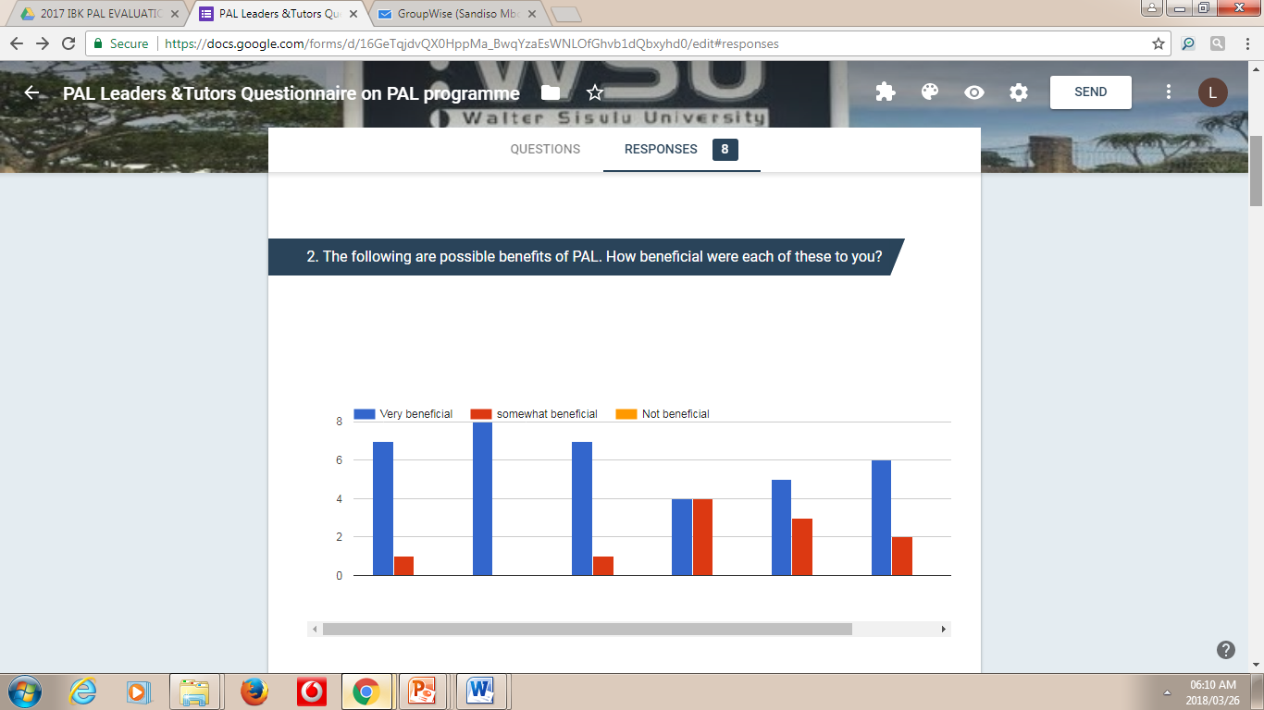
Pilot data analysis

Slide 10
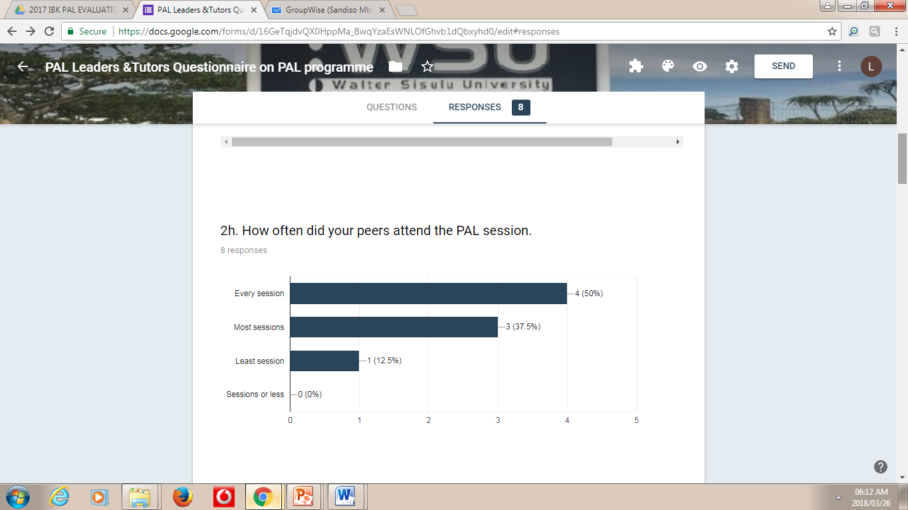
Analysis and findings

Slide 11
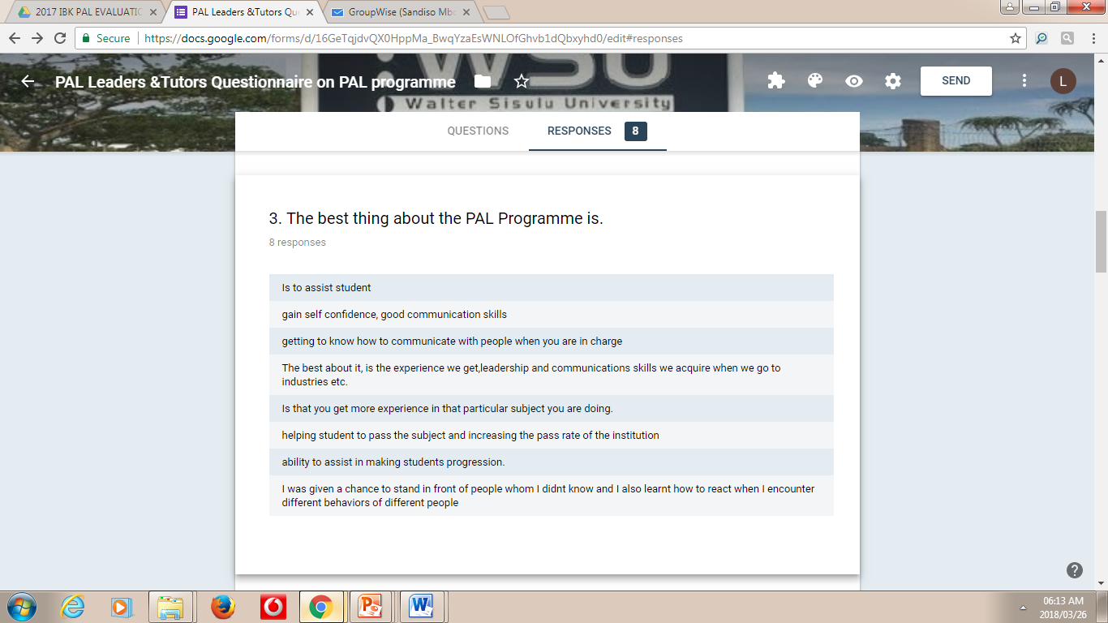
Analysis and findings

Slide 12
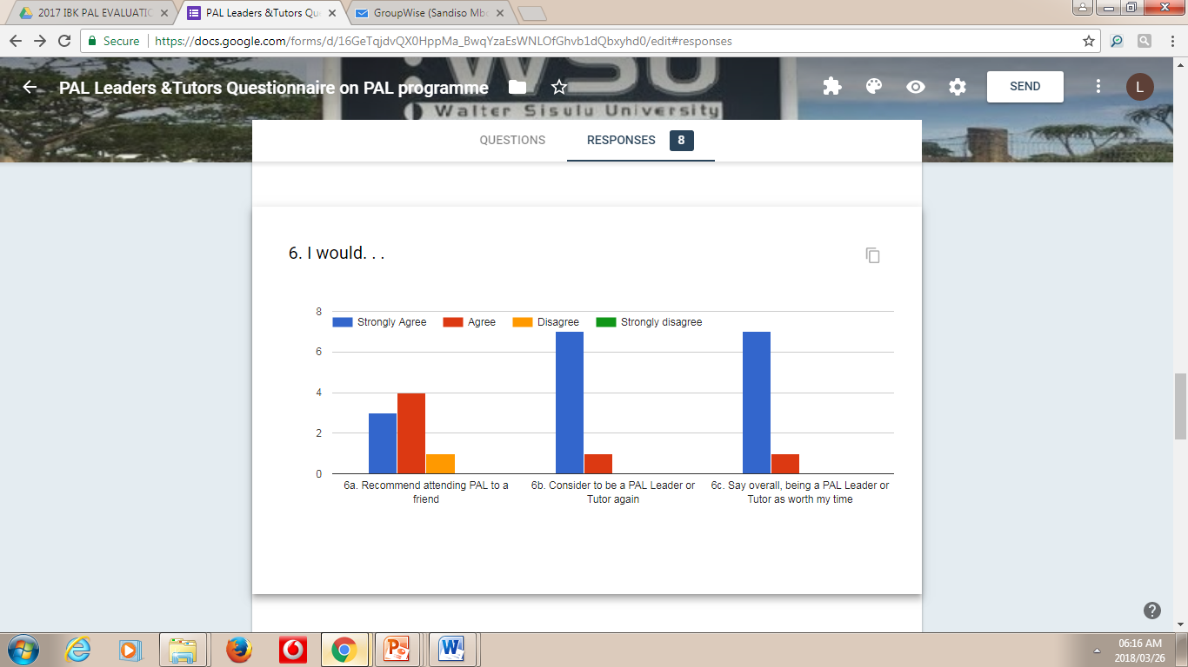
Analysis and findings

Slide 13
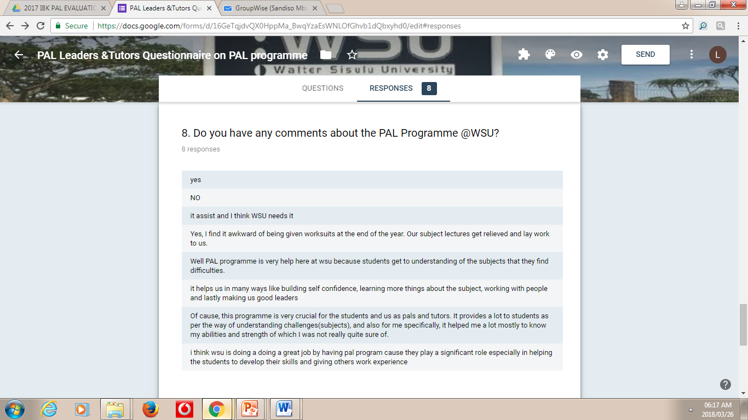
Analysis and findings

Slide 14
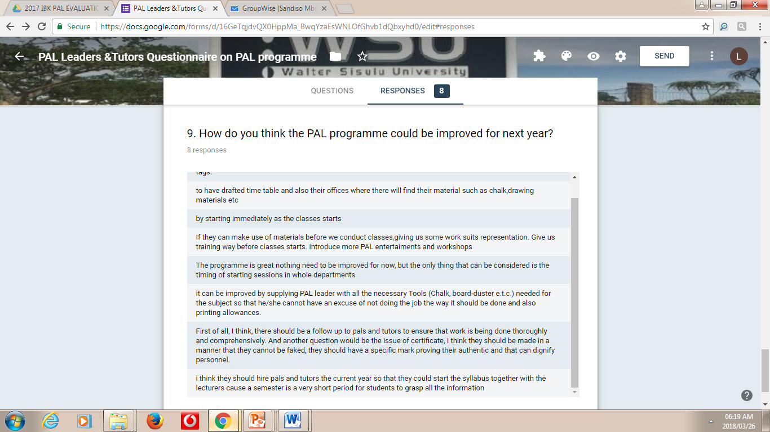
Analysis and findings

Slide 15
Findings
PAL Leaders feel part and parcel of the institution.
Establish good relations with both the students and staff members.
Their communication, problem-solving ,team work and facilitation skills is enhanced.
They gain work experience

Slide 16
Recommendations and conclusion
Based on the findings ,it is evident that the PAL Programme does not only benefit students who receive the intervention but also PAL Leaders who facilitate the session as well, which shows the importance of the programme at WSU.
PAL programme must not only be offered on high risk courses but on all first year students in order to create a culture of peer support and collaboration.
All PAL Leaders who have been part of the programme before must join the coordinators during trainings and workshops in order to share their experiences with the new PAL Leaders.
Through the PAL Program , students rapidly adapt to the institutional culture , attain epistemic access and easily gain ontological access.

Slide 17
“Enkosi”
I Thank You

