Slide 1

Peer assisted learning (pal) at the periphery of student holistic development
SABELO PETER (WSU)

Slide 2
INTRODUCTION AND BACKGROUND
Referring to epistemological access and student success ,the Higher Education Summit in 2010 outlined that the process of student development is multi-fold and that institutions have the obligation to adapt their ‘curriculum and teaching strategies to suit the student population that the country has to respond effectively to the needs of the societal issues(DHET, 2010).
This notion was consistent to the need for academic transformation in the education system of the country in order to address the needs of society by providing labour market with high level competencies necessary for the growth of modern economy (DoE,1997).
This meant ,“Exposing students to new experiences and perspectives –providing opportunities that offer powerful learning experiences that shape people’s development”(Quinlan,2011:5).

Slide 3
INTRODUCTION AND BACKGROUND
Subsequent to that , various approaches have been attempted by different universities to realise this transformation process, from teaching and learning strategies, quality enhancement discussions, foundation programmes, student support models ,curriculum renewal , increasing the duration of degrees among other strategies.(CHE,2012)
Hence, student academic support programmes ,like PAL programme, Work Integrated learning (WIL), Service Learning (SL)have been highlighted as one of the mechanism that have the potential to address the needs of society by providing labour market with holistic and responsive graduates(WSU, 2015).
It is against this background that this study investigated the role played by the PAL program in WSU, in developing and producing well rounded students- responsive to deficiencies that pervade the South African social, economic, and educational landscape(DHET,2015).

Slide 4
HOLISTIC Development: central to the PURPOSE OF EDUCATION
Holistic development either explicitly or implicitly advocates a broader view of the educational process by prioritising the purposes of education (Quinlan, 2015).
This means going beyond knowledge and skills to include other aspects of being a person in society(Walpole,2007).
However, for large number of students, the purpose of education is to qualify them for a good job, not to help them build skills applicable in the widest variety of life experiences (Meyer, 2010).
Therefore, institutions of higher learning have an important role in shaping our future society because today’s university students will be tomorrow’s doctors, engineers, business managers, teachers, faith leaders, politicians, citizens, activists, parents and neighbours(DoE, 2014)

Slide 5
HOLISTIC DEVELOPMENT: central to the PURPOSE OF EDUCATION
Educational activities such as active pedagogies ,namely service learning, problem-based learning, peer assisted learning and discussion of moral dilemmas, interaction with diverse peers is also a vital aspect of holistic student development (Stewart,2012).
These pedagogies of academic understanding are more important in helping students to develop their values, sense of self, identity and purpose(Moores, 2010, ).
They include a shift from a more traditional teaching methodology to student-centered learning, and capitalizing on the gains from students teaching one another- each-one-assist-one (WSU PAL manual, 2017).

Slide 6
PAL PROGRAMme AT THE PERIPHERY OF STUDENT DEVELOPMENT
PAL programme as a developmental learning pedagogy expanded to students not due to an intelligent plan, but as a natural response to growing needs by an increasingly diverse heterogeneous student body (Arendale,2000).
According to Capstick , the object of the PAL program is “... portray an open, informal, cooperative environment, in which students are able to set the agenda and raise their concerns, which is overseen by a trusted and approachable individual, and is of value in adjusting to university, understanding course material, enhancing the ability to do well in assessed work and building confidence.” (Capstick, 2004, p.47)
Similar to other academic student development models , the programme is meant to improve student learning, lowering attrition rates in targeting high risk course not high risk students, raising student grades, and increasing re enrolment and graduation rates (Walpole, 2007).

Slide 7
PAL PROGRAMme IN THE WSU CONTEXT
Peer Assisted Learning (PAL) is a Centre for Learning and Teaching Development (CLTD) initiative that encourages cross year support between students registered for the same course.
Students from the year above support juniors by assisting them with their academic work. In line with Capstick(2007), PAL adopts a student -centred approach as a learning paradigm of choice .
Hence, the theories that underpin the PAL model are meant to help PAL Leaders develop strategies to help students’ master content in high risk course and help new student adapt and adjust to university environment(WSU, 2017).

Slide 8
WALTER SISULU UNIVERSITY(wsu) PAL PROGRAMme STRUCTURE
CAMPUS
PAL COORDINABTOR (S)
LAB ASSISTANTS
E-LEARNG ASSISTANTS
TUTORS
PAL LEADERS(SUBJECT)

Slide 9
PAL PROGRAMme IN THE WSU CONTEXT
All PAL leaders take part in a intensive two-day training which covers topics such as how students learn, as well as instructional strategies aimed at strengthening student academic performance.
Furthermore, during PAL sessions PAL Leaders are encouraged to take the facilitation approach and allow students an opportunity to become actively involved
(Arendale, 2005).
Although it is implied, one of the ideal objectives of the program is to also help PAL Leaders and the students to develop sustainable skills for socio-economic responsiveness(Walpole, 2007).

Slide 10
Theories that underpin the pal program
The PAL program mostly draws from a number of theories that advance corporative and collaborative learning.
”PAL participants can identify with PAL facilitators since they are fellow undergraduate students only slightly ahead in their academic degree” (Arendale, 2014:5).
However, for this paper the focus will be on two theories which have a significant bearing on this particular study .Namely, constructivism theory and cognitive theory. These are most widely accepted learning theories.
The theories are student-centred and in line with the WSU Policy on Curriculum Development (WSU,2018) for effecting a change in the learner's behaviour and improving students’ academic competence.

Slide 11
Cognitive Theory
Cognitivism focuses on the inner mental activities – opening the “black box" of the human mind for understanding how people learn. Mental processes such as thinking, memory, knowing, and problem-solving need to be explored. Knowledge seen as schema or symbolic mental constructions. Learning is defined as change in a learner’s schemata(Copper ,1993)
Consistent to Coppers explanation, PAL Leaders in the program are encouraged to view students as active and not passive information processors receiving information, processing it, storing it, and retrieving it for use in problem solving and other learning tasks critical to the development of the student (Gibbs,1988)
This fosters development of problem-solving skills through the processes of inquiry and discovery. As well, contribute to the socialisation of enlightened, responsible and constructively critical citizens. This is in line with the development of reflective capacity

Slide 12
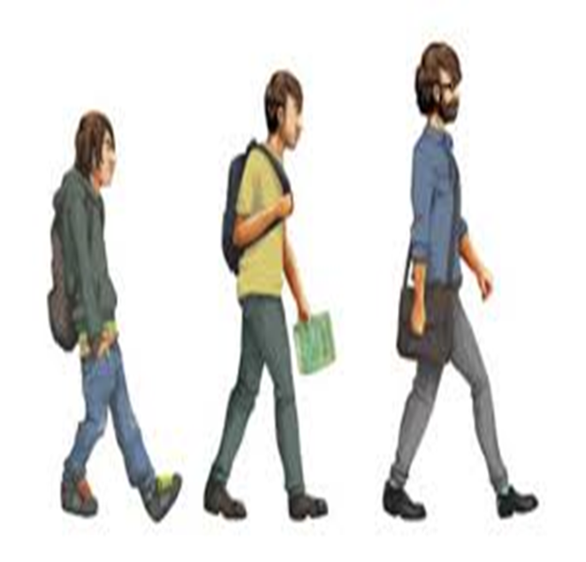
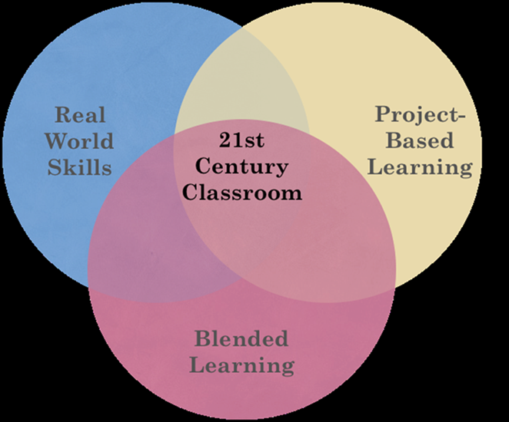
DISCUSSIONS DURING OUR pal TRAININGS
STUDENT DEVELOPMENT AND INDEPEDENCE
RESPONSIVENESS AND RELEVANCE

Slide 13
CONSTRUCTIVISM THEORY
Also according to Paiget , constructivist teaching is based on the belief that learning occurs as learners are actively involved in a process of meaning and knowledge construction(Piaget, 1958)
Viewing learning as a process during which learners build their own understanding of a subject by integrating information they are receiving with information they already know (Vygotsky, 1992).
PAL session as The Zone of Proximal Development (ZPD) PAL leaders are able to deeper understanding of both course content and dealing with diverse students group - lifelong learning ,which is impossible unless the student is actively involved in the construction of knowledge (Inhelder, 1958).

Slide 14
PAL Program as a PRAXIS Approaches to life long learning
A praxis led approach is reflective learning and about social justice were according to Grundy(1987), curriculum development should support three principles, :
  Learning should have enough space for criticality,
  Students should be active participants in the learning space
  Also that the facilitator should bring to the fore meaning to learning for students
In a developing state like South Africa, how curriculum is designed should be driven by social justice principles in practice. Where students become what Ledwith & Springett (2010) describe as participative activists in the academy and in their own communities.
PAL sessions train PAL Leaders to become proactive in their own learning and in the development of autonomous clinical and professional practice (Moon, 2004).

Slide 15
research questions
  To investigate the academic improvement resulting from the involvement in the program by the PAL Leaders
  To understanding the perceptions that PAL leaders have towards the programme before and after their involvement, and
  To examine the non-academic competencies acquired over the period the PAL leaders have been involved in the PAL programme.

Slide 16
Research Methodology
Empirical research was carried out using the qualitative research method. Focus group discussions were used as a qualitative research technique was used to obtain in-depth information(Morgan, 1998).
Quota sampling was used to select the number of respondents. Quota sampling suggest that the researcher selects a sample that is a representative of the relevant population( Du Plooy, 1987).
For this study 20 participants from various disciplines were invited to participate in the study. All of which were involved in the PAL program between 2015 and 2017.
As Morgan and Krueger (1993) states, the comparisons that participants make among each other's experiences and opinions are a valuable source of insights into complex behaviors and motivations.

Slide 17
results
Leadership and Self management skills: PAL sessions have challenged them to be open minded and deal with disappointment professionally.
Positive about the future: Clear about what to do after completing their studies.
Academic acumen : Higher order thinking skills( from surface learning to deep learning approaches) and the ability to develop assessment techniques. This was crucial especially for those from the Faculty of Education.
Praxis Led Approach: Theory is as critical as practice.
Valuing diversity :Being able to show empathy -understand and respecting other peoples points of view.

Slide 18
results
Decision-making and Leadership skills: Being able to make well-reasoned, informed, independent and reflective choices.
Knowledge and imagination : Having the academic grounding -being able to develop and apply methods of critical thinking and imagination to identify and comprehend multiple perspectives and complex problems.
Approach to learning : Having curiosity and a desire for learning, having the learning skills required for university and being an active inquirer .
Being able to participate in groups for learning: The ability to work with diverse students/people to solve problems or complete tasks.

Slide 19
CONCLUDING REMARKS
Assessment strategies that will instigate holistic development in our study guides.
“It is not the curriculum which shapes assessment , but assessment which shape the curriculum and embodies the purposes of higher education” (Brown & Knight, 1994:23)
Problematizing curriculum transformation , curriculum responsiveness for the sake of purposes of education
“interplay between knowledge and power, and the ability to question ‘what knowledge’, ‘whose knowledge’ and ‘who is served’ through knowledge selection into the curriculum”(CHE, 2018:”4).

Slide 20
CONCLUDING REMARKS
While the PAL programme in WSU was introduced to address the achievement gap in courses, it has the ability to enhances personal and professional skills for all that are involved.
  Students are looking for an approach to education that is in tune with their unique needs and skills, and one that prepares the them to become a well-rounded adults. As such, holistic education is based on the idea that the learner can be taught in a more natural and engaging way.(Scholar, 2014)
Students should be perceived as knowers not just observers in the academic space
    “…the notion that the learner constructs his or her own learning through relevant learning activities. The teacher's job is to create a learning environment that supports the learning activities appropriate to achieving the desired learning outcomes.
    (Biggs, 2003:2)

