Slide 1
The influence of SI on students’ academic performance
MOHALE MOSHIA AGNES & HLUNGWANI COLLEN

Slide 2
The Aim and Objectives
The aim of this study is: to explore the influence of SI on students’ academic performance.
The objectives:
To determine if the implementation of SI has an impact on students academic performance
To establish ways in which students find it compulsory to attend SI sessions

Slide 3
Background
Globally, mathematics and accounting are the modules that deal with calculations and are very difficult.
It appears that the pass rates of these modules have been a cause of concern. Educators and lecturers are tasked with a high level of responsibility to alleviate the challenges encountered by learners and students pursuing these modules (Naidoo & Paideya, 2015).
It is the responsibility of educators and learners to put more effort on teaching and learning at high school level. Which will result in learners being prepared for institutions of higher learning (Naidoo & Paideya, 2015).
The unpreparedness of lecturers due to lack of professional teaching qualifications reflect a signal of unprepared lecturers and unprepared students at the university level.

Slide 4
Cont…
The massification of education in South Africa affected the quality of education offered in higher institutions.
Research in higher education reveal that first year students experience challenges in traditional difficult modules, in this study the focus is mathematics and accounting.

Slide 5
The Development of SI
SI was developed by Dr Deanna Martin in 1973 at the University of Missouri at Kensas City.
The University of Limpopo has established a programme in January 2016, which is one of the most successful and effective strategy that is geared to assist students to become independent through peer-learning at the university level.
The programme is Supplemental Instruction (SI) designed with the aim of making student independent academically and also improve student performance through the assistance of SI Leaders (SILs). One of the objectives of SI is to improve learning skills such as thinking and reasoning; responsibility and reflection.

Slide 6
How SI Operates at University of Limpopo
SI is one of the 3 student support programme under Centre for Academic Excellence (CAE)
Deans and Directors identify difficult modules in all the Faculties within the institution.
SI Supervisor recruit, train and appoint SI Leaders (SIL) for SI activities with the help of the lecturer.
SIL is someone who is approachable to his/her students to create a conducive learning environment.
The SILs are recruited to conduct sessions on a peer level for students to better their understanding of the difficult module. It is a student-oriented programme However, it is voluntary to the students.
Then SI Leaders visit lecture halls during lessons to introduce and recruit students to become SI students.

Slide 7
Cont…
SI activities commences in the beginning of the year.
SILs collect session forms and resources from the Supervisor’s office before meeting with their students, returning the forms at the end of the month and get a student stipend.
SI Supervisor monitor and observe SI Leaders for developmental purposes
At the end of the year, SILs receive certificates as a token of appreciation and acknowledgement.
The challenges faced by previous SILs just to mention a few: venue, students imposing to have a session when they are about to write a test.
2016:46 SILs 2017:31 SILs 2018: 50 SILs

Slide 8
Cont.…
SI Supervisor
SI Leader
Student
Lecturer

Slide 9
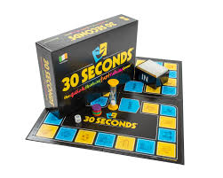
A 30 Second Game

Slide 10
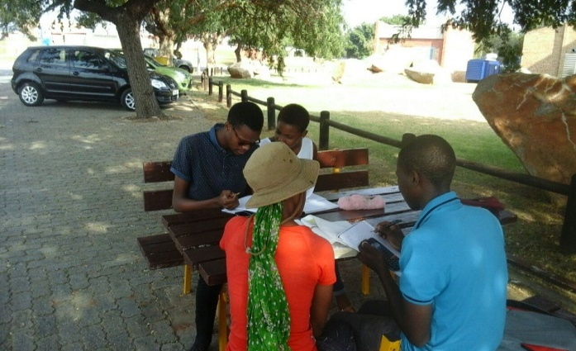
The ideal sitting arrangement of SI sessions…
The ideal sitting arrangement is informal. The picture below reflect SI session of 2016

Slide 11
Methodology
This study will adopt a mixed method approach.
Data will be collected through focus group interviews and individual interviews, and students’ database.
The sample size of thirty (30) participants. The study will adopt purposive convenient sampling technique.
30 students: 15 from Mathematics and 15 from Accounting

Slide 12
Data analysis
Data will be analysed using NVivo and SPSS.
The data will be collected and examined whether the students’ performance in mathematics and accounting has escalated through the intervention of SI programme.

Slide 13
Findings and Recommendations
This is an ongoing study.

Slide 14
References
Naidoo, J. and Paideya, V (2015). Exploring the possibility of introducing Supplemental Instruction at secondary level: south African Journal of Education Vol 35 No. 2

Slide 15
THANK YOU

